Slide 1
Genetic improvement programs for U.S. dairy cattle
John B. Cole
Animal Genomics and Improvement Laboratory
Agricultural Research Service, USDA, Beltsville, MD
john.cole@ars.usda.gov

Slide 2
U.S. dairy population & milk yield

Slide 3
U.S. DHI statistics (2016)
9.3 million U.S. cows
~75% bred AI
47% milk recorded through Dairy Herd Information (DHI)
  4.38 million cows
    83% Holstein
    10% crossbred
    6% Jersey
    <1% Ayrshire, Brown Swiss, Guernsey, Milking Shorthorn, Red & White
  17,339 herds
  253 cows/herd
  11,302 kg/cow
  ~35,000 cows in 800 herds on pasture

Slide 4
States with >200,000 DHI cows (Jan. 2017)
Idaho
232,571
Minnesota
246,649
New York
365,326
Wisconsin
761,978
Pennsylvania
337,951
California
919,136

Slide 5
DHI enrollment by breed (Jan. 2017)
Breed | Herds | Cows
Ayrshire | 63 | 3,205
Brown Swiss | 142 | 10,079
Guernsey | 84 | 3,948
Holstein | 13,348 | 3,595,206
Jersey | 838 | 321,706
Milking Shorthorn | 24 | 1,170
Crossbred | 1,873 | 466,995
All | 16,372 | 4,402,309

Slide 6
Data sources for genetic evaluations
Data collected
on farms
Dairy records
processing centers
Analytical laboratories
National database
Genetic evaluation
center
Milk processing
plants
On-farm
system only
Non-milk
recording farms

Slide 7
Data amounts (as of Sept. 2016)
Pedigree records 75,538,654
Animal genotypes 1,589,202
Lactation records (since 1960) 139,134,191
Daily yield records (since 1990) 684,182,260
Reproduction event records 196,505,574
Calving difficulty scores 27,991,336
Stillbirth scores 18,470,886

Slide 8
Primary traits evaluated
Yield
  Milk, fat, and protein
Conformation
  Overall and individual traits
Longevity
  Productive life, cow livability
Fertility
  Conception and pregnancy rates
Calving
  Dystocia and stillbirth
Disease resistance
  Somatic cell score

Slide 9
U.S. genetic-economic indices (2017)
Trait | Relative value (%)
 | Net merit | Cheese merit | Fluid merit | Grazingmerit
Milk yield | –0.7 | –7.9 | 20.4 | –0.5
Fat yield | 23.7 | 20.1 | 24.3 | 20.7
Protein yield | 18.3 | 22.0 | 0.0 | 16.0
Productive life (PL) | 13.4 | 11.4 | 13.8 | 7.8
Somatic cell score (SCS) | –6.5 | –7.0 | –3.2 | –5.5
Udder composite (UC) | 7.4 | 6.3 | 7.6 | 7.5
Feet/legs composite (FLC) | 2.7 | 2.3 | 2.8 | 2.8
Body weight composite (BWC) | –5.9 | –5.0 | –6.0 | –6.1
Daughter pregnancy rate (DPR) | 6.7 | 5.7 | 6.9 | 17.9
Heifer conception rate (HCR) | 1.4 | 1.2 | 1.4 | 2.5
Cow conception rate (CCR) | 1.6 | 1.4 | 1.7 | 4.4
Calving ability index (CA$) | 4.8 | 4.1 | 4.9 | 4.5
Cow livability (LIV) | 7.4 | 6.2 | 7.5 | 5.0

Slide 10
Genetic trend – net merit

Slide 11
Traditional evaluation summary
Evaluation procedures have improved
Fitness traits have been added
Effective selection has produced substantial annual genetic improvement
Indexes enable selection for overall economic merit
Fertility evaluations prevent continued decline

Slide 12
Genomic evaluation system
Provides timely evaluations of young bulls for purchasing decisions
Increases accuracy of evaluations of bull dams
Assists in selection of service sires
  Particularly for traits with low reliability
High demand for semen from genomically evaluated 2-year-old bulls
Funded by farmers, not government

Slide 13
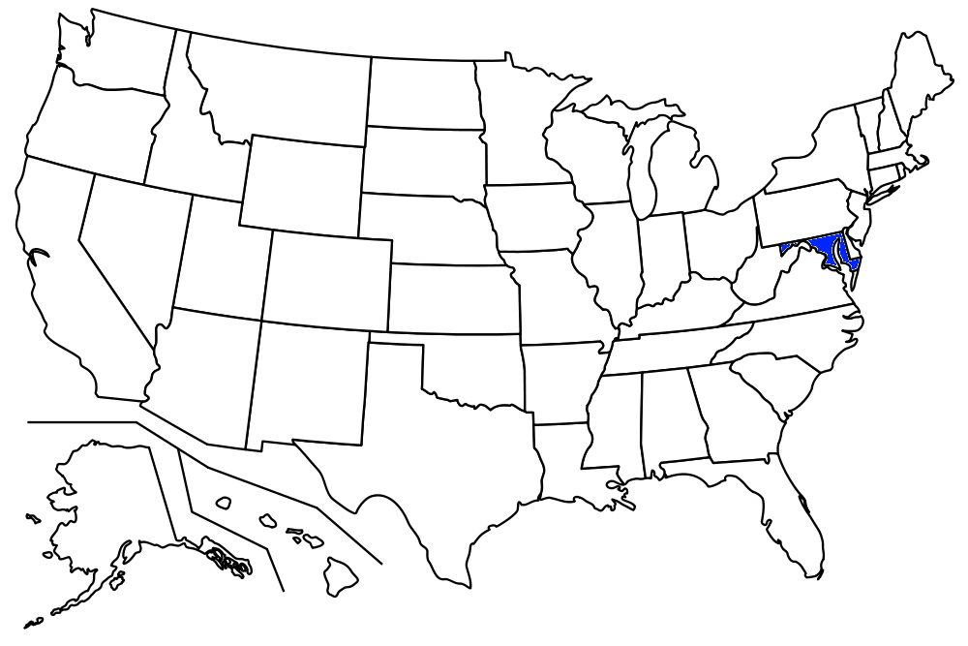
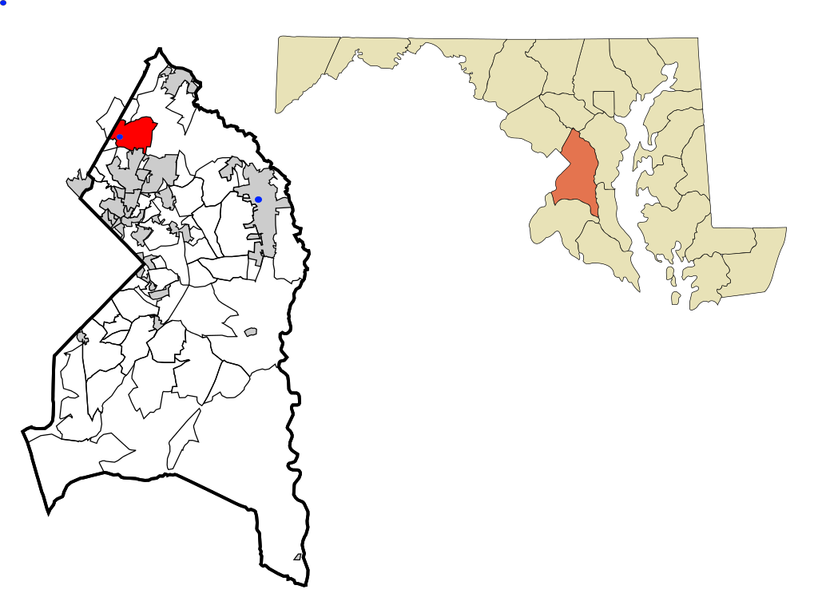
Government–industry collaboration
Animal Genomics and Improvement Laboratory (AGIL) , Agricultural Research Service, USDA
  Responsible for research and development to improve the evaluation system
  Located in Beltsville, Maryland
  Dr. John Cole, Acting Research Leader
Council on Dairy Cattle Breeding (CDCB)
  Responsible for approving changes,
  receiving data, and computing and
  delivering U.S. genetic evaluations for
  dairy cattle
  Located in Bowie, Maryland
  Dr. João Dürr, CEO

Slide 14
Council on Dairy Cattle Breeding
CDCB
PDCA
NAAB
DRPC
DHI
Purebred Dairy
Cattle Association
National Association of Animal Breeders
Dairy Records
Processing Centers
Dairy Herd
Information
3 members from each organization
Total of 12 voting members
2 nonvoting industry members

Slide 15
Genomic data flow
Animal manager/owner
DNA samples
DNA samples
genomic
evaluations
DNA laboratory
DNA samples
AI organization,
breed association
genotypes
genotypes
nominations,
pedigree data
genotype
quality reports
genomic
evaluations
Council on Dairy
Cattle Breeding (CDCB)

Slide 16
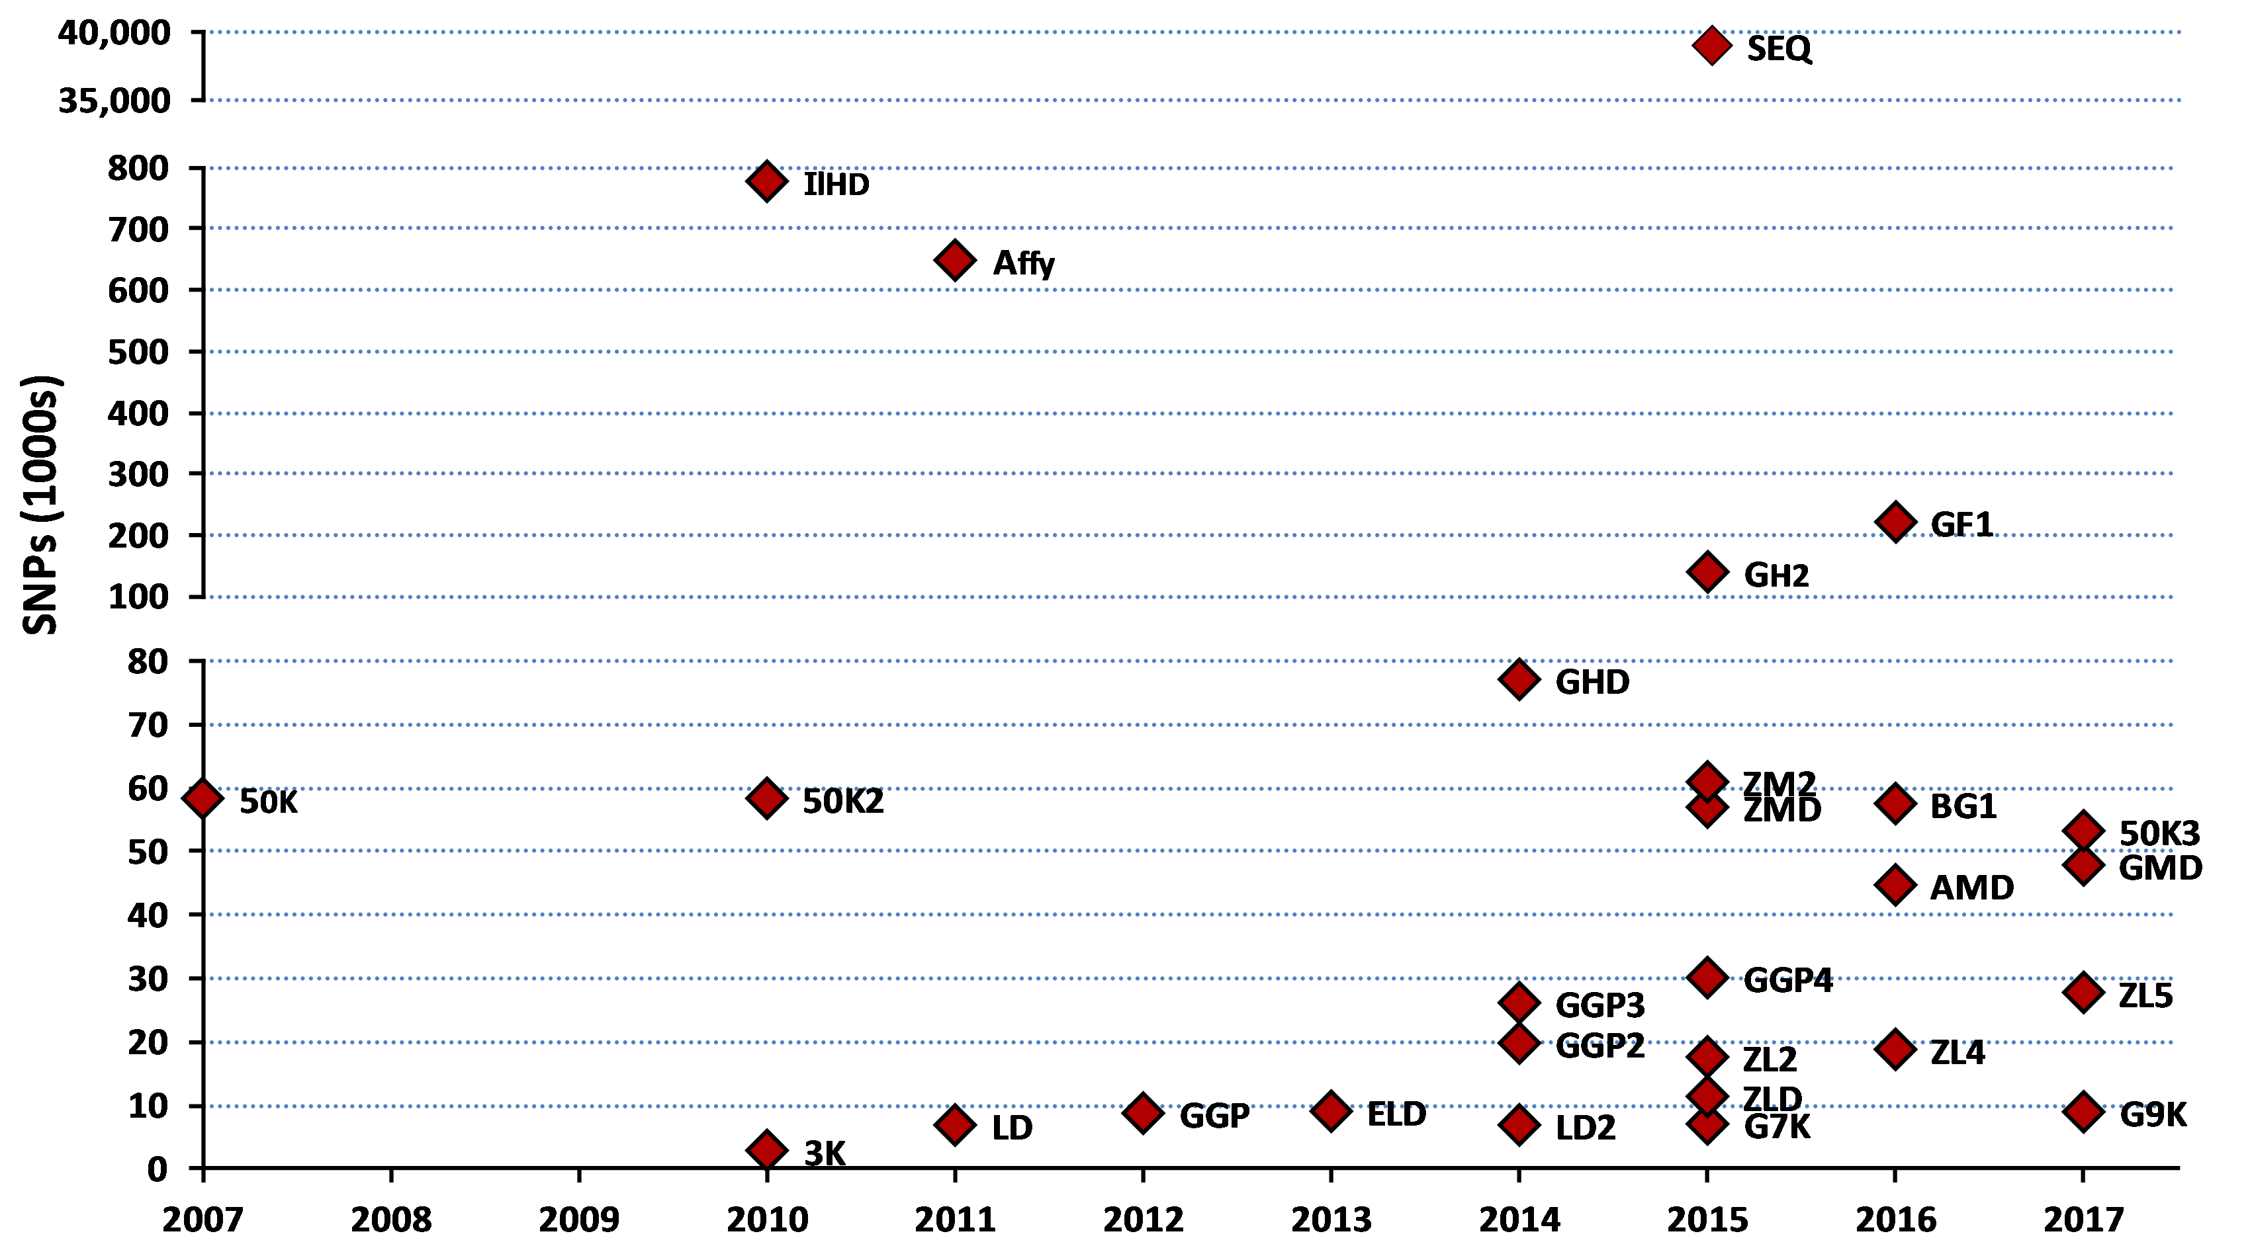
Genotyping chip history

Slide 17
Evaluation flow
Animal nominated for genomic evaluation by approved nominator
DNA source sent to genotyping lab (2015)
Source | Samples (no.) | Samples (%)
Blood | 6,893 | 2
Hair | 124,523 | 31
Nasal swab | 1,903 | <1
Semen | 277 | <1
Tissue | 252,468 | 64
Unknown | 10,906 | 3

Slide 18

Evaluation flow (continued)
DNA extracted and placed on chip for 3-day genotyping process
Genotypes sent from genotyping lab
to CDCB for accuracy review
  60,671 SNPs used in
  genomic evaluation

Slide 19
Information sources for evaluations
Traditional evaluations of genotyped bulls and cows used to estimate SNP effects
Combined final evaluation
  Sum of SNP effects for an animal’s alleles
  Polygenetic effect
  Traditional evaluation
Pedigree data used and validated by genotypes

Slide 20
Genotypes evaluated
Imputed, young
Imputed, old (young cows included before March 2012)
<50K, young, female
<50K, young, male
<50K, old, female
<50K, old, male (≤ 20 bulls)
≥50K, young, female
≥50K, young, male
≥50K, old, female
≥50K, old, male
2009
2010
2011
2012
2013
2014
2015
2016
2017

Slide 21
US reference population (August 2017)
Breed | Reference population |  |  |  | Total genotypes
 | Bulls |  | Cows
Holstein | 36,933 |  | 409,593 |  | 1,656,430
Jersey | 5,260 |  | 77,714 |  | 200,070
Brown Swiss | 6,729 |  | 2,633 |  | 31,488
Ayrshire | 796 |  | 295 |  | 7,692
Guernsey | 470 |  | 748 |  | 3,235
Crossbred |  |  |  |  | 59,905

Slide 22
Holstein prediction accuracy
Trait | Bias* | Reliability (%) | Reliability gain (% points)
Milk (kg) | −80.3 | 69.2 | 30.3
Fat (kg) | −1.4 | 68.4 | 29.5
Protein (kg) | −0.9 | 60.9 | 22.6
Fat (%) | 0.0 | 93.7 | 54.8
Protein (%) | 0.0 | 86.3 | 48.0
Productive life (months) | −0.7 | 73.7 | 41.6
Somatic cell score | 0.0 | 64.9 | 29.3
Daughter pregnancy rate (%) | 0.2 | 53.5 | 20.9
Sire calving ease | 0.6 | 45.8 | 19.6
Daughter calving ease | −1.8 | 44.2 | 22.4
Sire stillbirth rate | 0.2 | 28.2 | 5.9
Daughter stillbirth rate | 0.1 | 37.6 | 17.9
*2013 deregressed value – 2009 genomic evaluation

Slide 23
Parent ages (marketed Holstein bulls)

Slide 24
Genetic choices
Before genomics:
  Progeny-tested bulls with daughter records (PTA)
  Young bulls with parent average (PA)
After genomics:
  Young animals with DNA test (GPTA)
  GPTA reliability of ~70% for Holstein NM$ compared with ~35% for PA and ~85% for PTA

Slide 25
Why genomics works for dairy cattle
Extensive historical data available
Well-developed genetic evaluation program
Widespread use of AI sires
Progeny-test programs
High-value animals worth the cost of genotyping
Long generation interval that can be reduced substantially by genomics

Slide 26

Dairy breeding is international
Genotype alliances
  North America (US, Canada, UK, Italy)
  Ireland, New Zealand
  Netherlands, Australia
  Eurogenomics (Denmark/Sweden/Finland, France, Germany, Netherlands/Belgium, Spain, Poland)
Interbull genomic multitrait across-country evaluation (GMACE)
  Proposed exchange of SNP effects (SNPMACE)

Slide 27
Haplotypes affecting fertility
Name | Chromo- some* | Location** (Mbp) | Carrier frequency (%) | Earliest known ancestor
HH1 | 5 | 63.2** | 3.8 | Pawnee Farm Arlinda Chief
HH2 | 1 | 94.9 – 96.6 | 3.3 | Willowholme Mark Anthony
HH3 | 8 | 95.4** | 5.9 | Glendell Arlinda Chief, Gray View Skyliner
HH4 | 1 | 1.3** | 0.7 | Besne Buck
HH5 | 9 | 93.2 – 93.4 | 4.4 | Thornlea Texal Supreme
JH1 | 15 | 15.7** | 24.2 | Observer Chocolate Soldier
JH2 | 26 | 8.8 – 9.4 | 2.6 | Liberators Basilius
BH1 | 7 | 42.8 – 47.0 | 13.3 | West Lawn Stretch Improver
BH2 | 19 | 11.1** | 15.6 | Rancho Rustic My Design
AH1 | 17 | 65.9** | 26.0 | Selwood Betty’s Commander
*Bos taurus autosome (BTA) **Causative mutation known; Mbp = megabase pairs

Slide 28
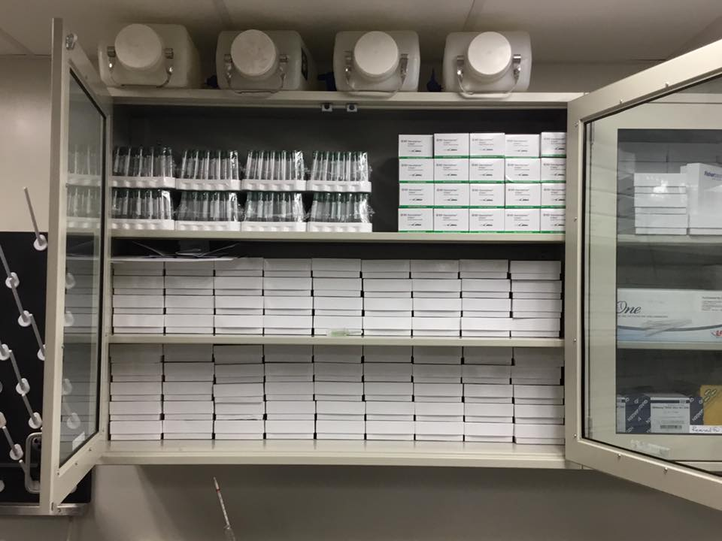
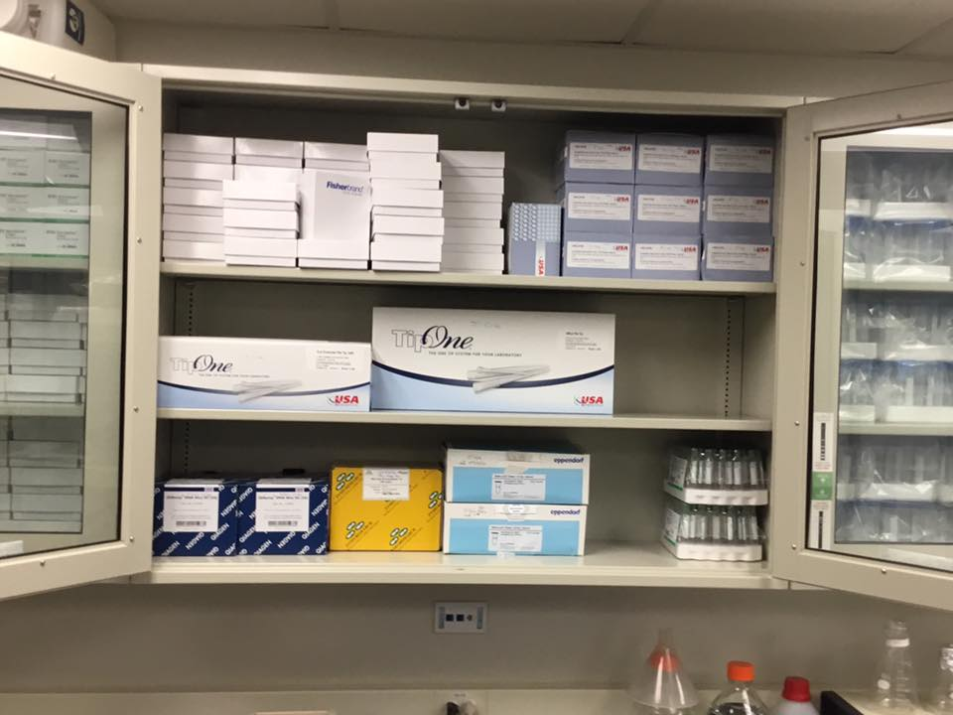
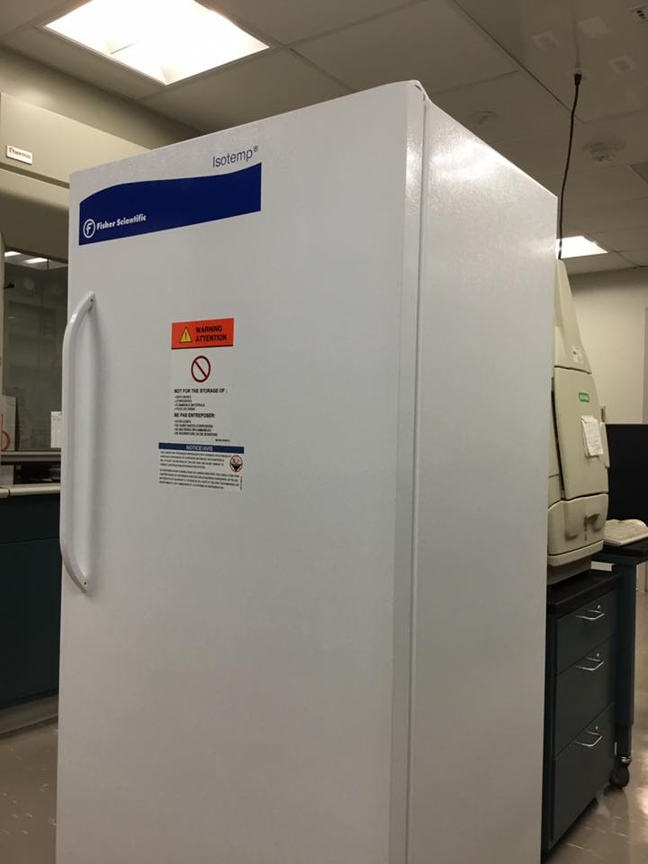
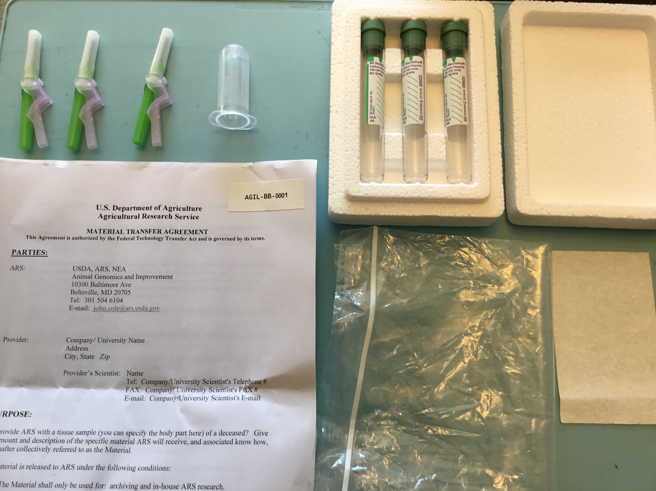
New US Dairy Calf DNA BioBank

Slide 29
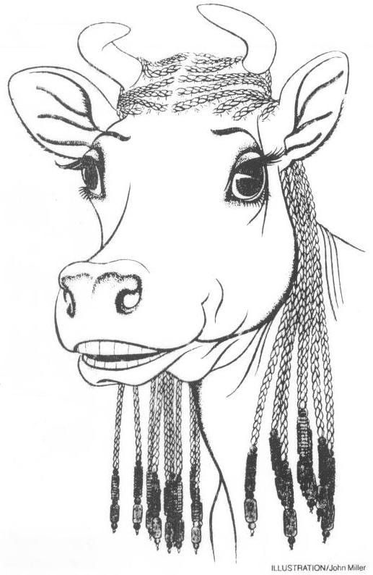
Impact of genomics on breeders
Haplotype and gene tests used in selection and mating programs
Trend towards a small number of elite breeders that are investing heavily in genomics
About 30% of young males genotyped directly by breeders since April 2013
Over 65% of breedings to genomic bulls
Prices for top genomic heifers can be very high
(e.g., $265,000)

Slide 30
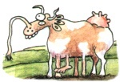
Impact of genomics on dairy producers
General
  Reduced generation interval
  Increased rate of genetic gain
  More inbreeding/homozygosity?
Sires
  Higher average genetic merit of available bulls
  More rapid increase in genetic merit for all traits
  Larger choice of bulls for traits and semen price
  Greater use of young bulls

Slide 31
Where are we going with new traits?
Changes in production economics
Technology produces new phenotypes or reduces costs of collecting them
  New traits can be predicted on all genotyped animals without collecting progeny records
  Phenotyping costs are shared among millions of animals
Better understanding of biology
Recent review by Egger-Danner et al. (Animal, 2015)

Slide 32
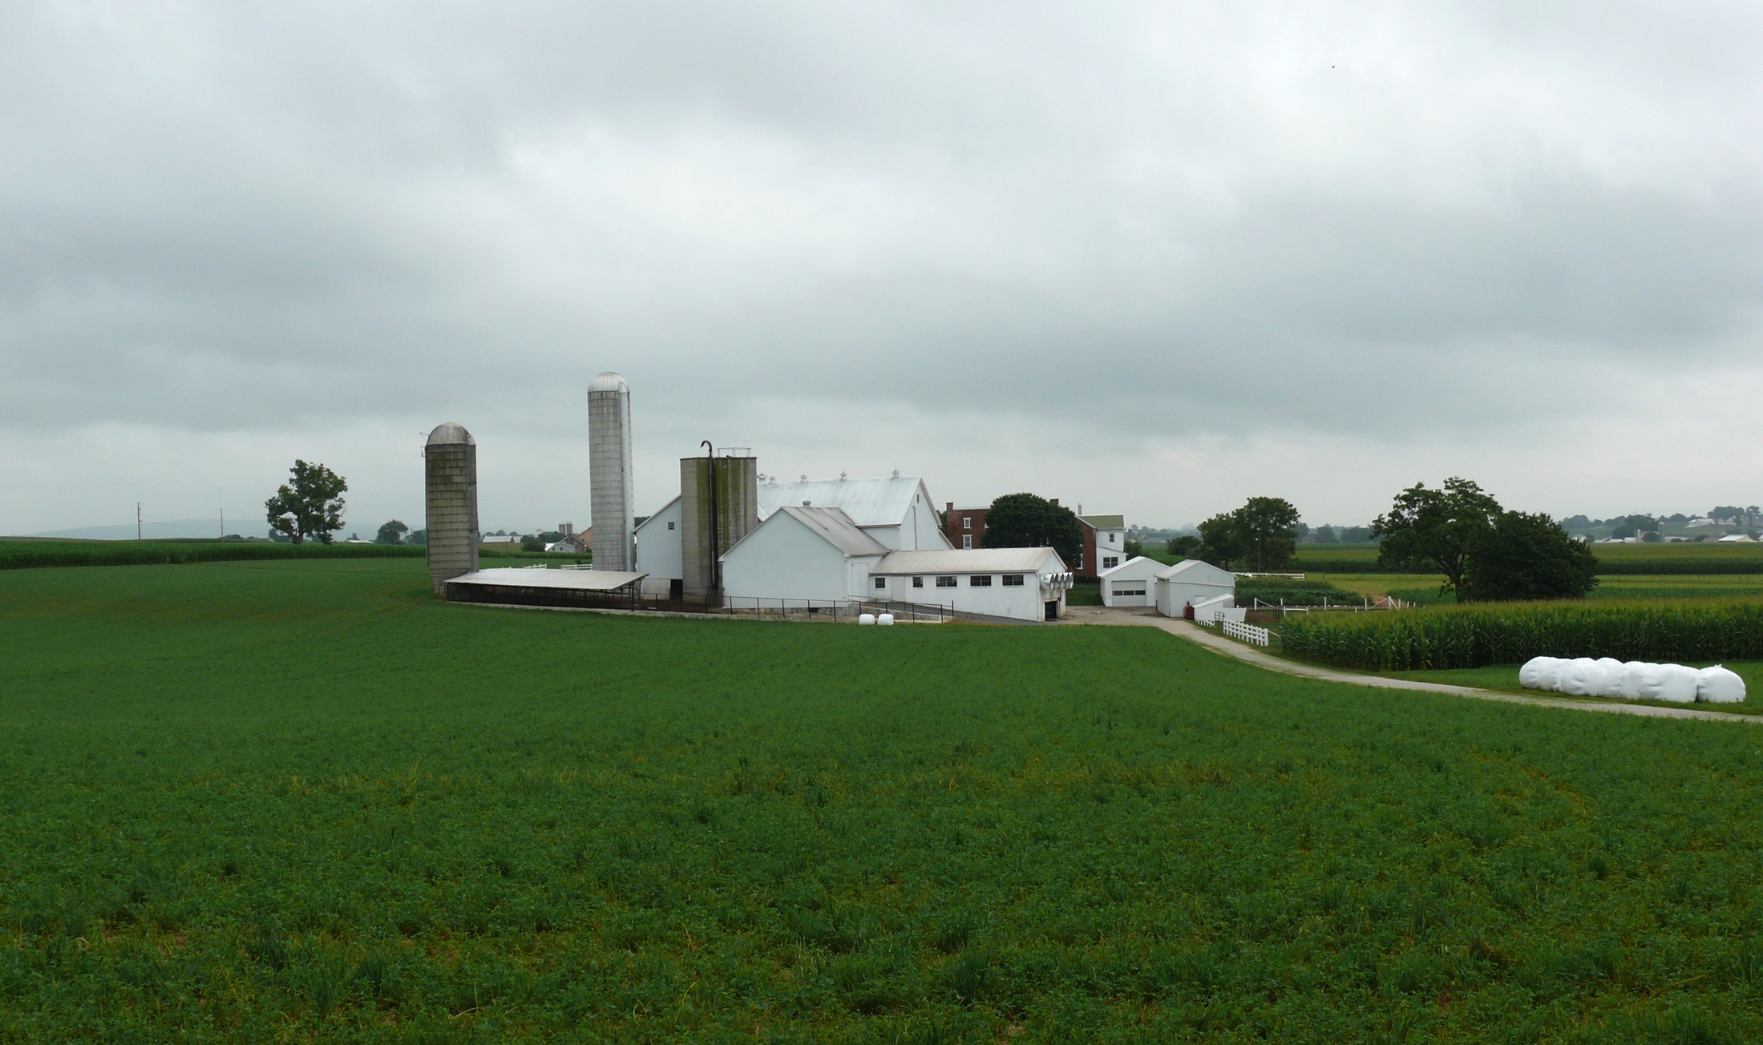
Where do new traits come from?
Barn: Flooring type, bedding materials, density, weather data
Cow: Body temperature, activity, rumination time, feed & water intake
Herdsmen/consultants: Health events, foot/claw health, veterinary treatments
Parlor: yield, composition, milking speed, conductivity, progesterone, temperature
Silo/bunker: ration composition, nutrient profiles
Pasture: soil type/composition, nutrient composition
Laboratory/milk plant: detailed milk composition, mid-infrared spectral data
Source: http://commons.wikimedia.org/wiki/File:Amish_dairy_farm_3.jpg

Slide 33
Examples of new traits
Claw health
(Van der Linde et al., 2010)
Cow health
(Parker Gaddis et al., 2013)
Embryonic development
(Cochran et al., 2013)
Immune response
(Thompson-Crispi et al., 2013)
Methane production
(de Haas et al., 2011)
Milk fatty acid composition (Soyeurt et al., 2011)
Persistency of lactation
(Cole et al., 2009)
Thermoregulation
(Dikmen et al., 2013)
Residual feed intake
(Connor et al., 2013)
Cheesemaking properties
(De Marchi et al., 2009)
Superovulation & embryo transfer
(Parker Gaddis et al., 2017)
Adaptation to automated (robotic) milking (Vosman et al., 2014)
Metabolic diseases
(Pryce et al., 2016)
Udder health
(Soyeurt et al., 2012)
Cow temperament
(Kramer et al., 2013)
Milking efficiency
(Lovendahl et al., 2012)

Slide 34
New traits should have value to farmers
Milk yield | Feed intake
Conformation | Greenhouse gas emissions
High
Phenotype value
Low
Low
High
Measurement cost

Slide 35
Genotypes can be applied to many traits
An animal’s genotype is good for all traits
Traditional evaluations are required for accurate estimates of SNP effects
Traditional evaluations not currently available for heat tolerance or feed efficiency
Research populations could provide data for traits that are expensive to measure
Will resulting evaluations work in target population?

Slide 36
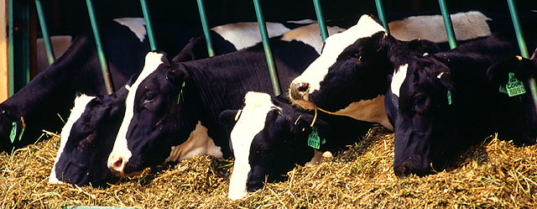
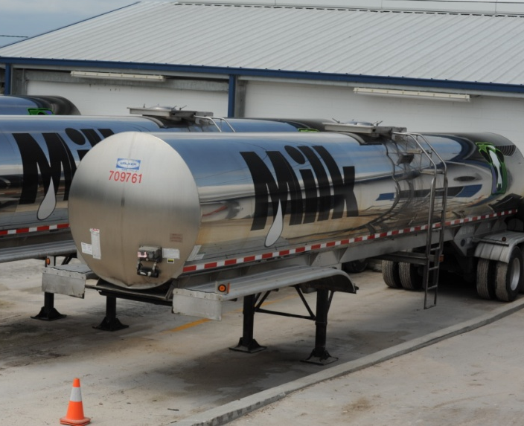
Traditional phenotyping scheme
Current milk recording
Many farms participate
Low-intensity phenotyping (few measurements per cow)
Well-suited to traits with low recording costs
Source: ARS, USDA
Source: North Florida Holsteins
Source: J.B. Cole

Slide 37
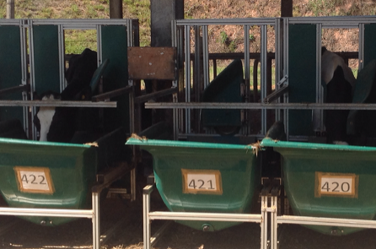
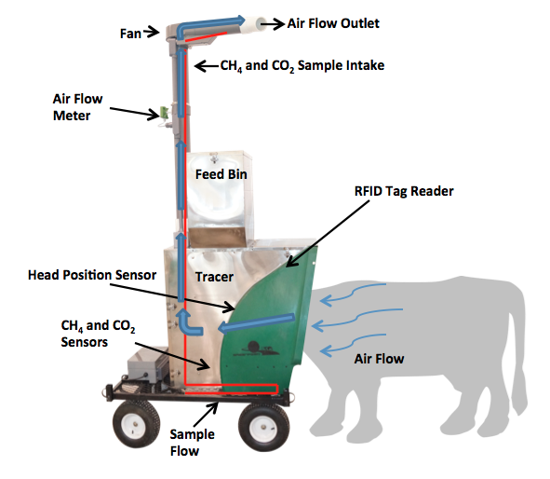
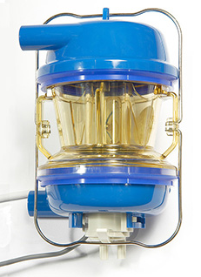
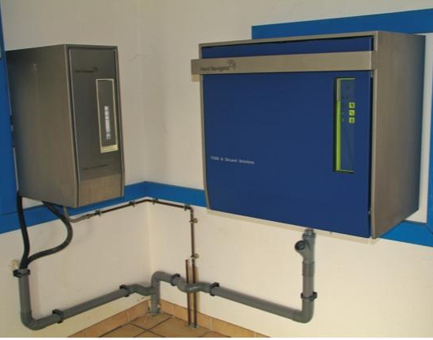
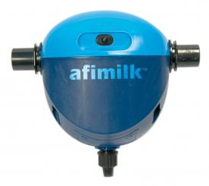
Alternative phenotyping scheme
Few farms
Intensive phenotyping (many measurements per cow)
Use cases
  Expensive-to-measure traits
  Developing countries
Source: J.B. Cole
Source: http://c-lockinc.com/
Source: http://www.afimilk.com/
Source: http://goo.gl/wu8YtR

Slide 38
What are current data challenges?
We need more frequent sampling for modern management
  Samples do not need to be evenly spaced across the lactation
Some large farms do not see a value proposition in milk recording
On-farm data are growing, but not collected in a central database
Notes:
38
38

Slide 39
Technology may not be the answer
New technologies often require considerable capital investment
They sometimes fail to work or do not deliver the promised gain
  Fundamental premise may be flawed
  The tool could be imperfect
  Products may be rushed to market prematurely
Data are most useful when combined with observations from many farms
This inevitably involves risk

Slide 40
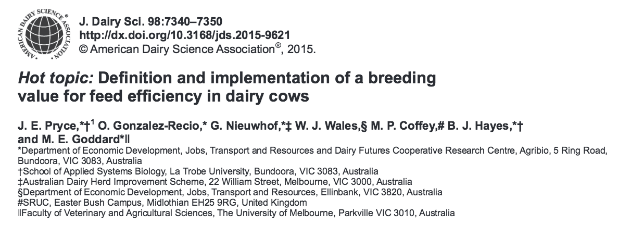
Collaboration is essential
When new traits are expensive, it takes a consortium to collect the data needed for genetic evaluation.
Notes:
40
40

Slide 41
New health traits in US
Increasing demand for health evaluations
  Consumer demand
  Improve profitability → decreasing management costs
Health trait | Direct cost estimate*
Hypocalcemia | $38
Displaced abomasum | $178
Ketosis | $28
Mastitis | $72
Metritis | $105
Retained placenta | $64
*Liang et al. (2017); Donnelly et al. (2016)
Notes:
2

Slide 42

Phenotypic health data
Health event data available from DRMS (Raleigh, NC) for 6 common health traits
  Hypocalcemia/milk fever
  Displaced abomasum
  Ketosis
  Mastitis
  Metritis
  Retained placenta
Data collected from on-farm computer
systems
Recorded on a voluntary basis by farmers employees

Slide 43
US health evaluations
Genomic reliabilities
  40 – 49% for young animals
  44 – 56% for progeny-tested animals
Correlations with current traits as expected
Health traits will add no more than 4% improvement to lifetime net merit index (NM$)
Preparing pipeline to be ready for implementation
Official evaluations are planned for release in April 2018

Slide 44
Conclusions
Genomic evaluation has dramatically changed dairy cattle breeding
Rate of gain is increasing primarily because of a large reduction in generation interval
Genomic research is ongoing
  Detect causative genetic variants
  Find more haplotypes affecting fertility
  Improve accuracy through more SNPs, more predictor animals, and more traits

Slide 45
Acknowledgments
Appropriated project ARS 8042-31000-002-00, “Improving dairy animals by increasing accuracy of genomic prediction, evaluating new traits, and redefining selection goals,” Agricultural Research Service, USDA
Kristen Gaddis, Dan Null, Paul VanRaden, and George Wiggans
Council on Dairy Cattle Breeding

Slide 46
Disclaimer
Mention of trade names or commercial products in this presentation is solely for the purpose of providing specific information and does not imply recommendation or endorsement by the United States Department of Agriculture.

Slide 47
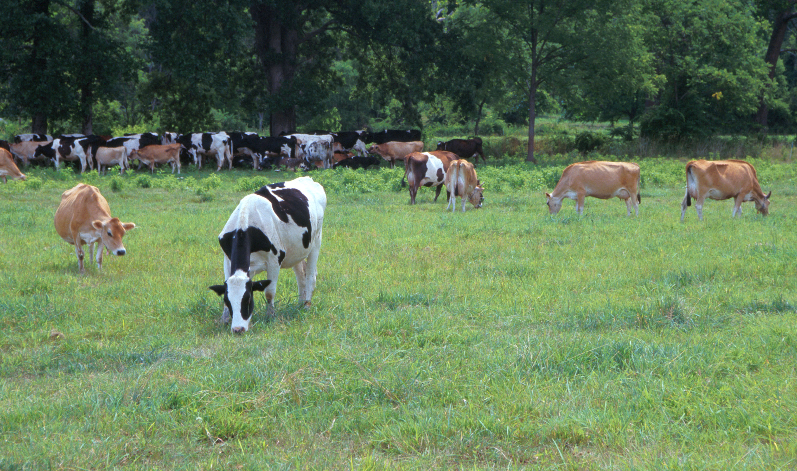
Questions?
AIP web site:
http://aipl.arsusda.gov
Holstein and Jersey crossbreds graze on American Farm Land Trust’s
Cove Mountain Farm in south-central Pennsylvania
Source: ARS Image Gallery, image #K8587-14; photo by Bob Nichols

